Slide 1

Database Design & Implementation
Order Management System
A Capstone Project for Software Engineering and Database Design

Slide 2

STUDENT 1: Introduction & Requirements
Project Overview: Building a Robust E-commerce Backend
Project: Order Management System
Core Goal
Design a scalable and efficient system to manage orders, inventory, and payment processing for an e-commerce platform.
Developing the database core for an Online Electronics Shop.
Real-World Application
This project mimics a live operational e-commerce environment, demanding high data integrity and transactional consistency.

Slide 3

Defining the Problem Domain
Our mini-world centers on an online store specializing in electronic devices. The system must support the complete lifecycle of a transaction:
Customers browse and purchase products.
They place orders and process payments.
The system tracks inventory and manages shipments.
The primary objective is to simplify and automate order tracking, billing, and real-time inventory control to ensure customer satisfaction.

Slide 4

Key Entities and Relationships
1
Core Entities
Customers, Products, Orders, Order_Items, Payments, Shipments, and supporting tables like Categories and Addresses.
2
One-to-Many Relationships
Crucial links include One Customer → Many Orders, and One Order → Many Order_Items.
3
Transactional Links
Each Order must be tied to a single Payment transaction and a single Shipment record for integrity.
4
Assumption on Addresses
Customers can maintain multiple addresses, allowing clear distinction between billing and various shipping locations.

Slide 5
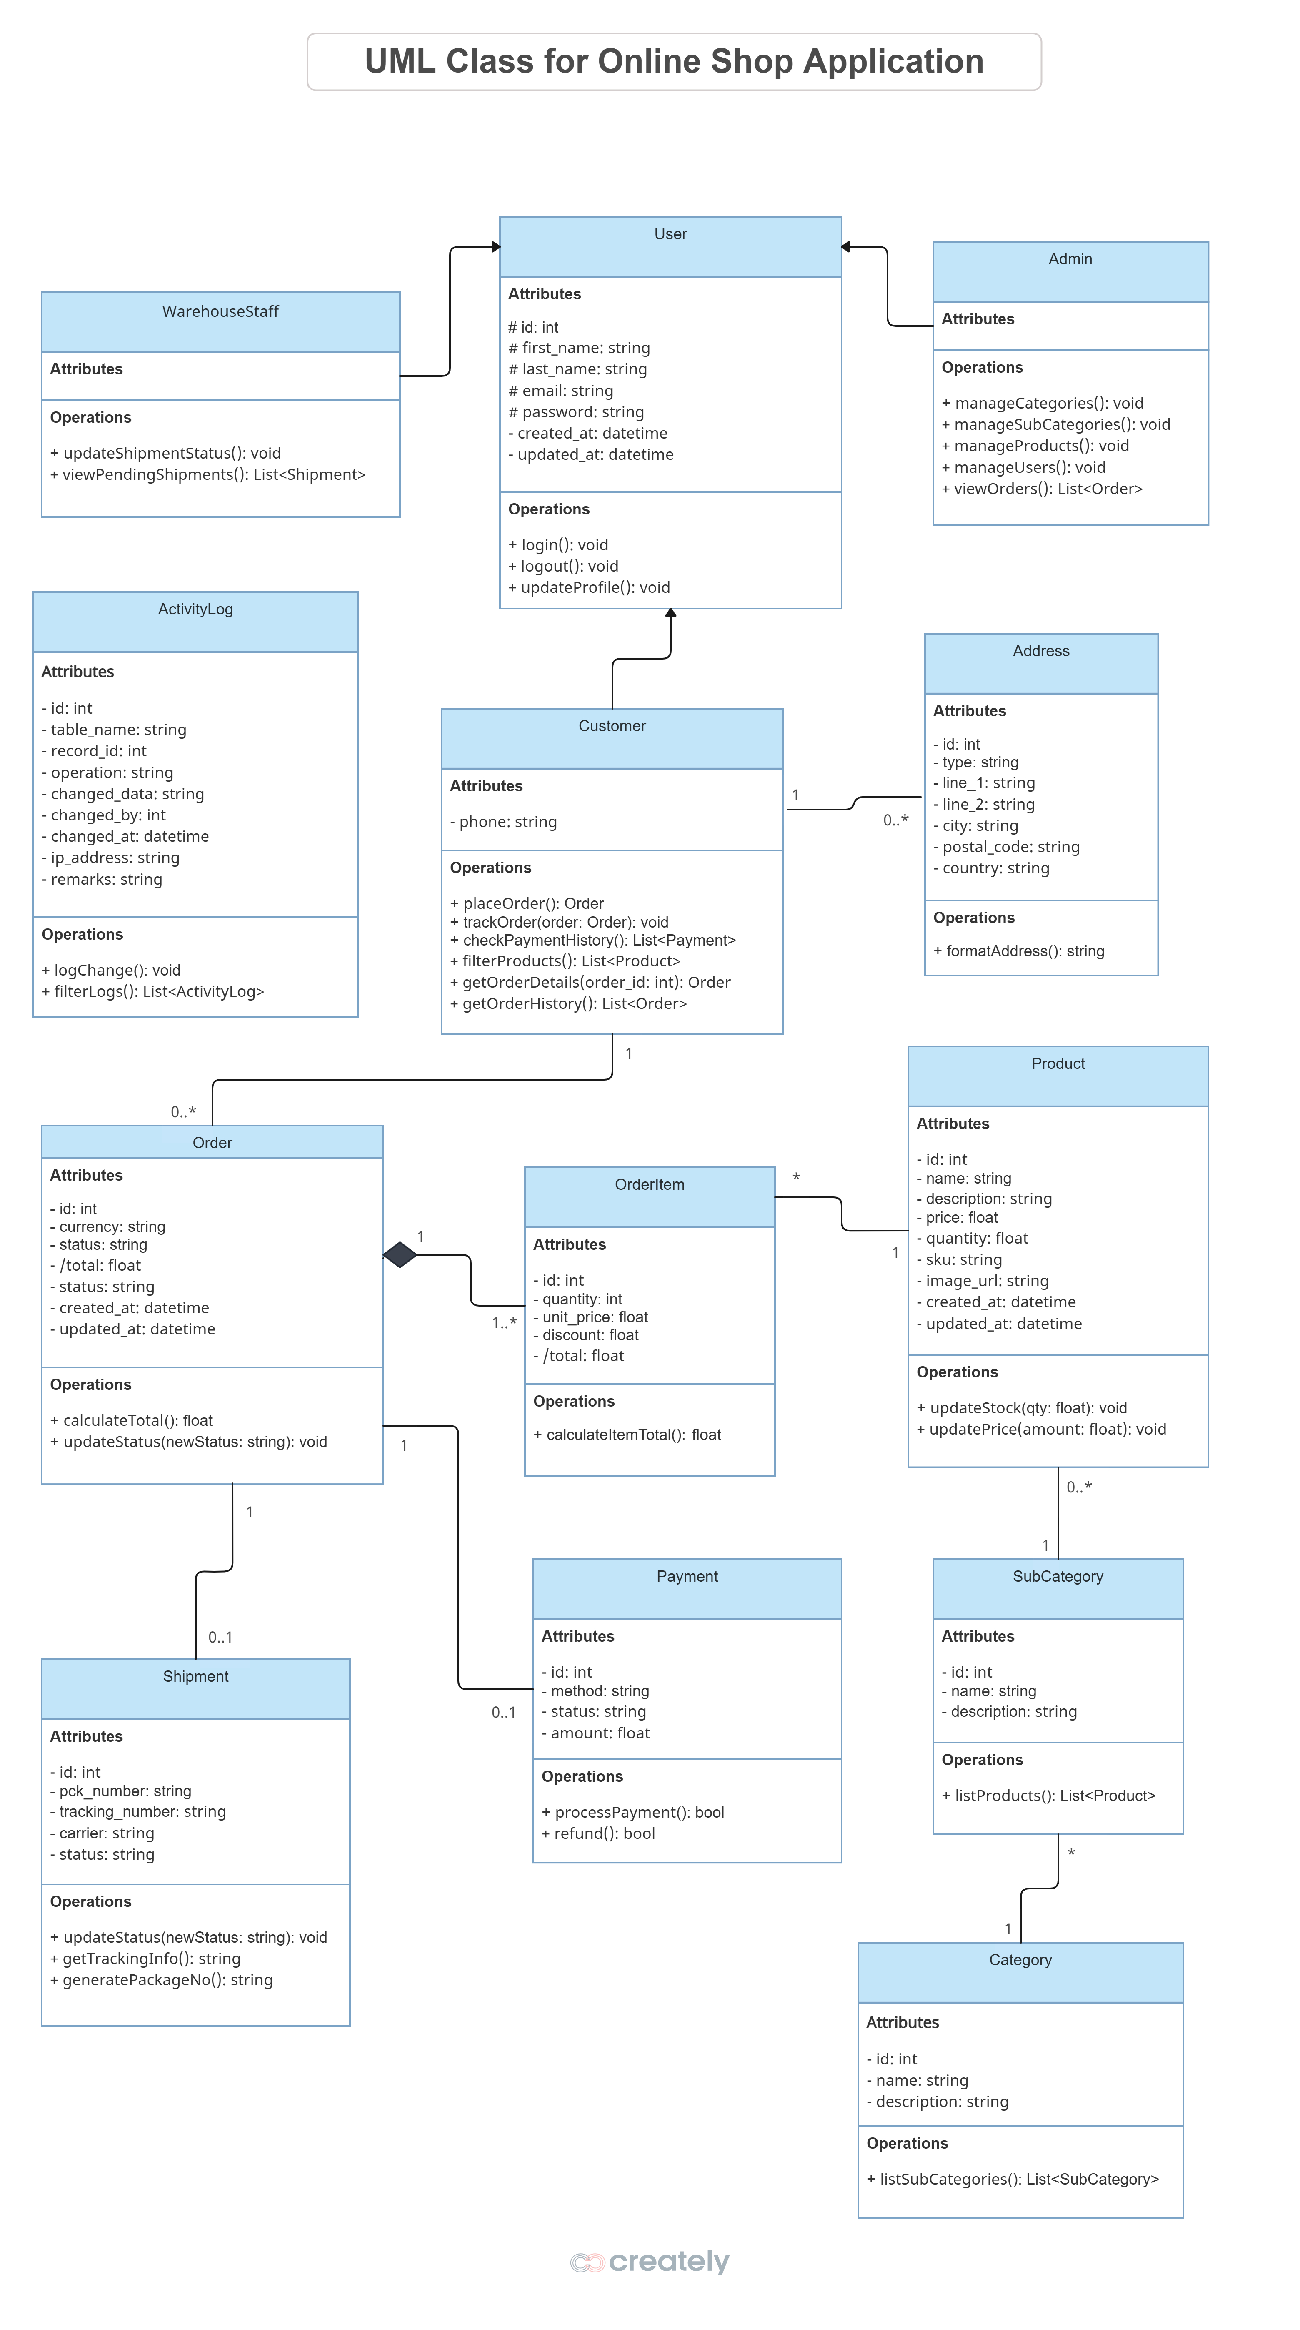

The Conceptual ER Diagram
The Entity-Relationship (ER) model organizes our data, visualizing how our entities interact and defining the system's structure. Key transaction flow follows the path: Customer → Orders → Order_Items → Products.
This model ensures no orphaned records and mandates that all transactions are fully accounted for.

Slide 6


STUDENT 2: Database Schema & Normalization
Implementing the Schema: SQL Data Definition Language (DDL)
The Database Schema defines the tables, columns, and constraints, ensuring data integrity across the system. We use standard SQL DDL statements for implementation.
CREATE TABLE orders ( id INT AUTO_INCREMENT PRIMARY KEY, customer_id INT NOT NULL, total FLOAT, status ENUM('pending','shipped','delivered','cancelled'), FOREIGN KEY (customer_id) REFERENCES customers(id));
Data Integrity: Utilizing PRIMARY and FOREIGN KEY constraints prevents inconsistent data, while ENUM types (e.g., for 'status') restrict values to acceptable operational states.

Slide 7
Ensuring Efficiency through Normalization
Normalization minimizes data redundancy and eliminates update anomalies, ensuring our database remains efficient and consistent over time. We aimed for BCNF.
1
2
First Normal Form (1NF)
Second Normal Form (2NF)
Ensuring all attributes within tables are atomic (indivisible) and each column holds a single value.
Eliminating partial dependencies—every non-key attribute must depend on the entire primary key.
3
4
Third Normal Form (3NF)
Boyce-Codd Normal Form (BCNF)
Removing transitive dependencies where non-key attributes depend on other non-key attributes.
The strongest form achieved by ensuring every determinant is a candidate key.
Example Transformation: We split repeating category and subcategory information from the Product table into new Category and Subcategory tables, satisfying 3NF.

Slide 8
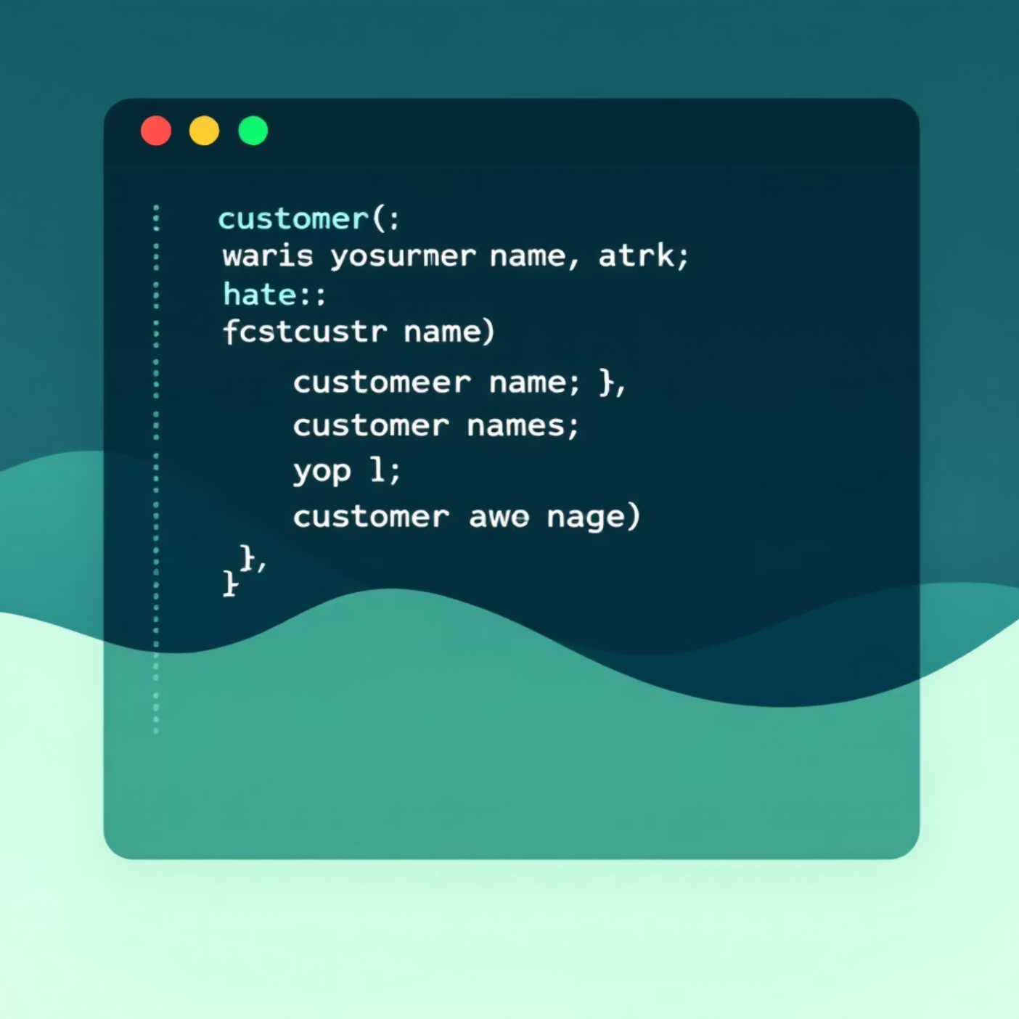
STUDENT 3: Sample Data & Queries
Populating the Database: Sample Data
Customers
Includes three active profiles: Aino, Elias, and Sanna, each with associated billing and shipping addresses.
Products
Stocking high-value items: iPhone 15 Pro, Dell XPS 13, and popular accessories like JBL Flip 6.
Orders
A total of 6 sample orders, fully linked to corresponding payment records and shipment tracking details.
Screenshots of SELECT * FROM customers; and SELECT * FROM products; are included in the appendix to verify data entry.

Slide 9

Essential Queries for Operational Reporting
We developed robust SQL queries leveraging joins, aggregation, and subqueries to extract meaningful business data.
1
Aggregation with HAVING
2
Complex Subquery
SELECT customer_id, SUM(total) FROM orders GROUP BY customer_id HAVING SUM(total) > 1000;
SELECT name FROM products WHERE id IN (SELECT product_id FROM order_items WHERE order_id=1);
Identifies high-value customers who have spent over $1,000 across their orders.
Retrieves the names of all products associated with a specific order (Order ID 1).
3
Data Manipulation (DML)
UPDATE orders SET status='cancelled' WHERE id=5; DELETE FROM shipments WHERE id=6;
Screenshot confirming the output of the high-value customer query.
Demonstrates critical business logic for updating order status and deleting shipment records.

Slide 10
Key Challenges and Final Outcomes
Challenge 1: Database Design Complexity
What was difficult?
Designing entity relationships between Customers, Orders, Products, and Payments without redundancy.
How we solved it:
Created an ER diagram, reviewed dependencies, and refined structure through multiple iterations until achieving BCNF normalization.
Challenge 2: Normalization & Data Integrity
What was difficult?
Identifying and removing partial and transitive dependencies across tables.
How we solved it:
Applied step-by-step normalization (1NF → 2NF → 3NF → BCNF) and used foreign key constraints to maintain referential integrity.
Challenge 3: Query Writing & Optimization
What was difficult?
Writing multi-table JOINs and aggregate queries that produced accurate results.
How we solved it:
Broke queries into smaller parts, tested each join independently, and used indexes on key columns to boost performance.

Slide 11
Key Challenges and Final Outcomes
Challenge 4: Data Insertion Errors
What was difficult?
Inserting data when foreign key dependencies were not satisfied.
How we solved it:
Followed a logical data insertion order: Categories → Products → Customers → Orders → Payments → Shipments. Used transaction control (COMMIT / ROLLBACK) for safe testing.
Challenge 5: Team Collaboration & Version Control
What was difficult?
Coordinating work among multiple students using shared SQL scripts.
How we solved it:
Managed all stories and tasks through Atlassian JIRA and synchronized files using GitHub, ensuring version consistency and team accountability.
✅ Final Outcome:
Database fully normalized and functional.
All core SQL queries tested successfully.
System is scalable and ready for further development (analytics, authentication, UI).

Slide 12
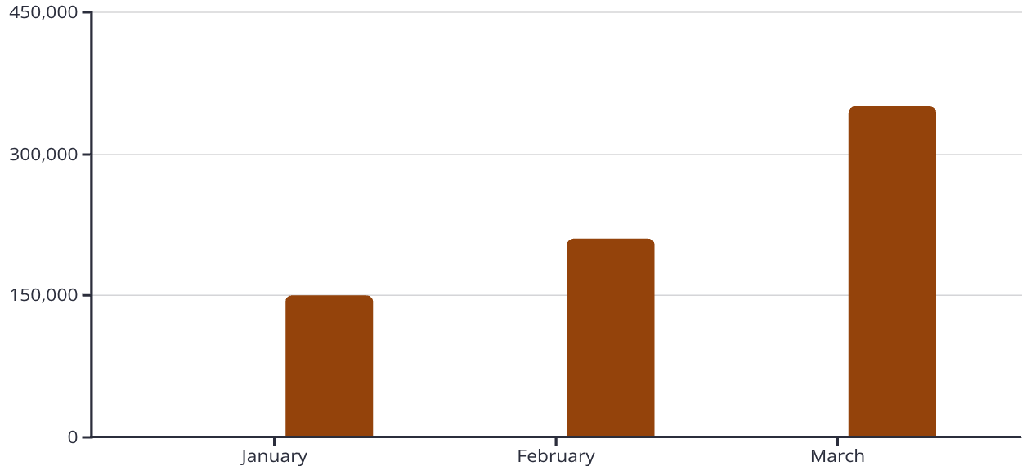
Reports & Conclusion
Real-Time Business Intelligence & Conclusion
The database is designed to generate critical operational reports directly from the live data tables.
Monthly Sales Report
SELECT MONTH(created_at) AS Month, SUM(total) AS Revenue FROM orders GROUP BY MONTH(created_at);
Aggregates total revenue by month to track sales trends and performance.
Pending Shipments Report
Orders Processed
Total Sales (USD)
SELECT o.id, c.first_name, s.status FROM orders o JOIN customers c ON o.customer_id = c.id JOIN shipments s ON s.order_id = o.id WHERE s.status != 'delivered';
Visualization of Orders Processed vs. Total Sales (Example Data)
Lists all customer orders that have not yet reached the 'delivered' status, aiding logistics management.
Conclusion: The Order Management System successfully meets all requirements, providing a robust, normalized, and query-efficient database for a modern e-commerce platform.

